Slide 1
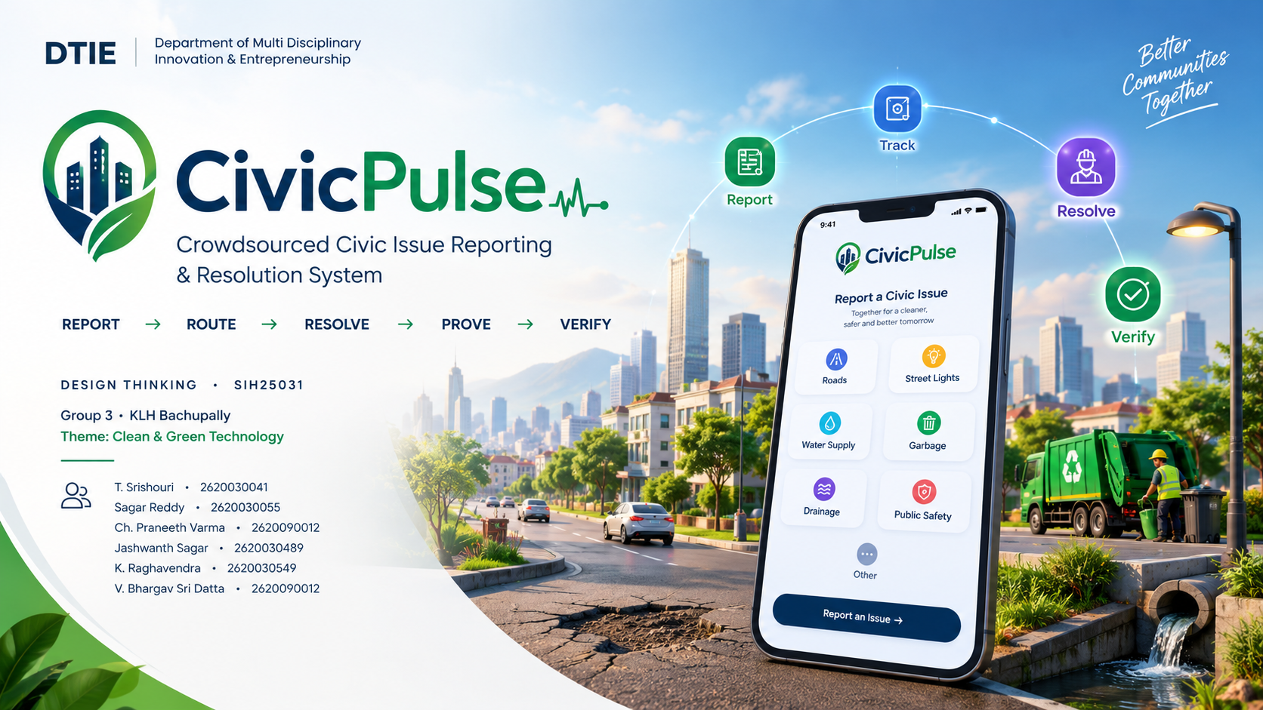

Slide 2
TEAM
02
The people behind CivicPulse
1
T. Srishouri
2
Sagar Reddy
3
Ch. Praneeth Varma
2620030041
2620030055
2620090012
4
Jashwanth Sagar
5
K. Raghavendra
6
V. Bhargav Sri Datta
2620030489
2620030549
2620090012
CIVICPULSE • DTIE • GROUP 3 • KLH BACHUPALLY
CLEAN & GREEN TECHNOLOGY

Slide 3
01 • DIRECTION
03
Vision & mission
VISION
MISSION
Build a transparent civic ecosystem where every reported issue has an owner, a deadline and proof of resolution.
Make civic reporting simple, traceable and evidence-backed through one connected workflow for citizens, field workers and municipal supervisors.
DESIGN PRINCIPLE
AI assists • authorized officials remain accountable • privacy-by-design • evidence-backed closure
CIVICPULSE • DTIE • GROUP 3 • KLH BACHUPALLY
CLEAN & GREEN TECHNOLOGY

Slide 4
02 • PROBLEM
04
The gap is not reporting — it is accountability
WHO owns it? • WHAT changed? • WAS it actually fixed?
REPORT
OWNER
PROGRESS
PROOF
Issue submitted
Who acts?
What changed?
Was it fixed?
VISIBLE ISSUES
FOLLOW-UP FRICTION
CLOSURE UNCERTAINTY
Potholes • waste • streetlights • sewage • waterlogging
Repeated complaints can fragment ownership and progress.
Without evidence, “resolved” may be hard to verify.
CIVICPULSE • DTIE • GROUP 3 • KLH BACHUPALLY
CLEAN & GREEN TECHNOLOGY

Slide 5
03 • RESEARCH
05
Research / facts / market & industry study
CivicPulse is designed around the full service journey, not a report form alone.
Citizen
01
Field worker
02
Fast reporting • GPS/photo • status visibility
Clear work order • exact location • evidence
Supervisor
03
Pilot measures
04
Queue • SLA risk • hotspots • audit trail
Assignment time • SLA • duplicate rate • verified closure
Prototype/pilot measures are proposed; the current deck does not claim real-world quantitative results.
CIVICPULSE • DTIE • GROUP 3 • KLH BACHUPALLY
CLEAN & GREEN TECHNOLOGY

Slide 6
04 • CUSTOMER
06
Target users — three perspectives
CITIZEN
FIELD WORKER
MUNICIPAL SUPERVISOR
“I reported it. What happened next?”
“Give me the right job with the right context.”
“Show me what needs attention first.”
Report • track • verify / reopen
Work order • location • evidence
Queue • SLA • hotspots • audit trail
CIVICPULSE • DTIE • GROUP 3 • KLH BACHUPALLY
CLEAN & GREEN TECHNOLOGY

Slide 7
05 • BENCHMARK
07
Competitors / benchmarks
Compare the workflow capabilities CivicPulse is designed to connect.
CAPABILITY
REPORT
ROUTING
SLA
PROOF
VERIFY / REOPEN
Typical reporting flow
●
—
—
—
—
Workflow-oriented platform
●
●
●
△
△
CivicPulse concept
●
●
●
●
●
Capability benchmark — not a claim about named commercial products.
CIVICPULSE • DTIE • GROUP 3 • KLH BACHUPALLY
CLEAN & GREEN TECHNOLOGY

Slide 8
06 • RISK
08
Risks & gaps to validate
AI accuracy
Privacy
Wrong category/severity suggestion
Mitigation: Human review remains important
Location + evidence may be sensitive
Mitigation: Privacy-by-design + role-based access
Duplicate detection
Deployment
False match / missed duplicate
Mitigation: Pilot validation + similarity tuning
Municipal integrations are complex
Mitigation: Start with academic-scale pilot
CIVICPULSE • DTIE • GROUP 3 • KLH BACHUPALLY
CLEAN & GREEN TECHNOLOGY

Slide 9
07 • SOLUTION
09
The Civic Loop — one ticket, one lifecycle
REPORT
TRIAGE
ASSIGN
ACT
PROVE
VERIFY
Photo / text / voice
GPS + timestamp
Category + severity
Duplicate check
Ward + department
Owner + SLA
Field work order
Live status
After-photo
Audit trail
Citizen confirms
or reopens
A report does not disappear after submission — it stays traceable through resolution and verification.
CIVICPULSE • DTIE • GROUP 3 • KLH BACHUPALLY
CLEAN & GREEN TECHNOLOGY

Slide 10
08 • STORYBOARD + ARCHITECTURE
10
One pothole, end to end
1
2
3
4
5
6
REPORT
TRIAGE
ASSIGN
ACT
PROVE
VERIFY
Photo + GPS
Category / severity
Ward + owner + SLA
Field work
After-photo
Confirm / reopen
SYSTEM ARCHITECTURE
USER LAYER
Citizen App • Field App • Municipal Dashboard
INTELLIGENCE
AI classification • duplicate similarity • severity suggestion
LOCATION + WORKFLOW
GIS / ward mapping • routing • SLA • escalation
DATA + SECURITY
PostgreSQL/PostGIS • object storage • HTTPS • RBAC • audit trail
CIVICPULSE • DTIE • GROUP 3 • KLH BACHUPALLY
CLEAN & GREEN TECHNOLOGY

Slide 11
09 • BUSINESS MODEL
11
Lean Canvas — CivicPulse
PROBLEM
CUSTOMER SEGMENTS
UVP
Unclear ownership
Progress uncertainty
Unverified closure
Citizens
Field teams
Municipal supervisors
Every civic issue gets
an owner, deadline
and proof.
SOLUTION
KEY METRICS
CHANNELS
Traceable ticket
Routing + SLA
Evidence + verification
Assignment time
SLA compliance
Verified closure
Satisfaction
Citizen interface
Municipal dashboard
Field workflow
DIFFERENTIATOR
COST STRUCTURE
VALUE / IMPACT
One connected
report-to-verification
civic loop
Prototype tools
Hosting / database
GIS / integrations
Less uncertainty
Better routing
Evidence-backed closure
CIVICPULSE • DTIE • GROUP 3 • KLH BACHUPALLY
CLEAN & GREEN TECHNOLOGY

Slide 12
10 • CAPITAL
12
Financial plan — prototype first
The current project is an academic-scale prototype. Real deployment cost needs a separate pilot study.
PEOPLE
DEVICES
SOFTWARE
LOCATION
6-member team
Smartphone + laptop
Prototype UI + sample data
Map / GPS concept
FUTURE COST DRIVERS
Hosting / database
GIS & mapping services
Municipal integrations
Pilot testing & support
CIVICPULSE • DTIE • GROUP 3 • KLH BACHUPALLY
CLEAN & GREEN TECHNOLOGY

Slide 13
11 • ROADMAP
13
From prototype to measurable civic pilot
01
02
03
04
PROTOTYPE
VALIDATE
PILOT
SCALE
Core reporting flow
+ sample data
Routing, SLA,
evidence, verification
Selected ward /
department + feedback
More departments,
integrations + GIS
SUCCESS MEASURES
Assignment time • SLA compliance • Duplicate-report rate • Verified closure • Citizen satisfaction
CIVICPULSE • DTIE • GROUP 3 • KLH BACHUPALLY
CLEAN & GREEN TECHNOLOGY

Slide 14
THE CIVIC LOOP
Every civic issue deserves
an owner, a deadline and proof.
REPORT
ROUTE
RESOLVE
PROVE
VERIFY
CivicPulse transforms a citizen observation into a measurable municipal action.
THANK YOU • QUESTIONS & DISCUSSION

